Slide 1
Company Acquisition Sentiment Analysis
By Ashika Anand Babu, Ramya Mahesh and Anusha Gangasani

Slide 2
CONTENTS
Data
Model
Graph
Output

Slide 3
DATA
Using 1000 purchased records from crunchbase
Using pygooglenews for scraping news articles related to company

Slide 4
MODEL
After combining the data scraped from news and crunchbase, we need to identify the sentiment w.r.t to every board member in the company and articles related to them.
Used NLTK vader for generating a sentiment score for an article title.

Slide 5
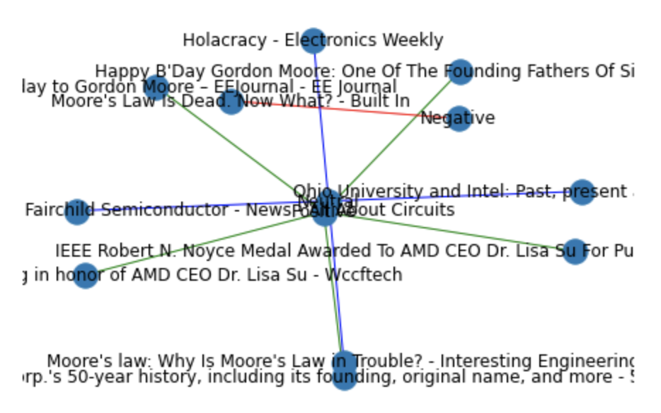
GRAPH

Slide 6
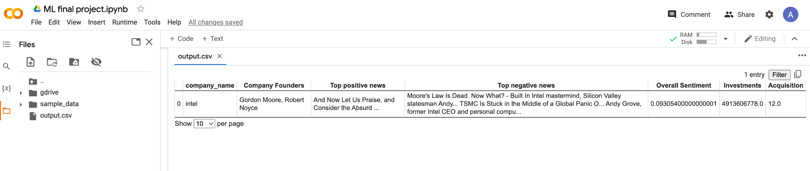
Output
Our output file looks like:

Slide 7
Thank You!

